Slide 1
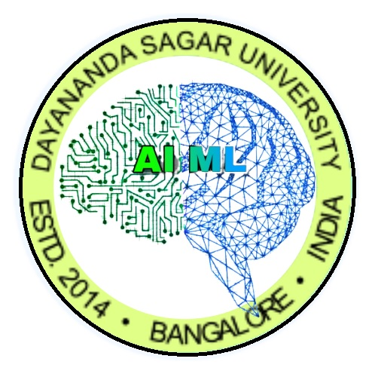

EXPLORATION OF
MULTI AGENT REINFORCEMENT LEARNING
DAYANANDA SAGAR UNIVERSITY
SCHOOL OF ENGINEERING
Department of Computer Science and Engineering (AIML)
Major Project Final Review
Under the Supervision
Mr. Pradeep Kumar K
Presented By:
Anirudh Sajith (ENG21AM0010)
Divith B S (ENG21AM0035)
Harsh Manalel (ENG21AM0046)

Slide 2
Overview
Introduction
Sustainable Development Goals
Problem Statement and Solution
State of the Art-work
Novelty of Proposed Work
Framework
Environment
Architecture
GNN Message Model
Algorithm
Comparison of Results
References

Slide 3
Introduction
Domain: Multi-Agent Reinforcement Learning (MARL)
Objective: Develop AI agents that can learn and optimize strategies in a simulated soccer environment.
Reinforcement Learning (RL): A type of machine learning where agents learn to make decisions by receiving rewards or penalties from their actions.
Multi-Agent Context: Involves multiple interacting agents with potentially conflicting or cooperative goals.
Exploration vs. Exploitation: Key challenge where agents must balance exploring new strategies and exploiting known successful ones.

Slide 4
Problem Statement and Solution
Problem: Traditional MARL methods struggle with efficient coordination and spatial awareness.Poor performance in environments requiring high cooperation and exploration.
Solution: Propose GACRL – a novel MARL algorithm that utilizes GNNs for structured agent communication. Adapts exploration based on task success (landmark coverage).

Slide 5
Sustainable Development Goals
(Industry, innovation, and infrastructure)
Goal 9: Industry, Innovation and Infrastructure – GACRL promotes intelligent multi-agent systems.
Goal 11: Sustainable Cities and Communities – Smart coordination for autonomous agents (e.g., traffic systems, drones).
Goal 12: Responsible Consumption and Production – Optimized agent learning reduces computational waste.

Slide 6
State of the Art-work
Paper Title | Journal Name and year | Technology/ Design | Advantages | Limitation
Multi-agent Reinforcement Learning: A Survey | ICARCV, 2006 [b1] | Overview of cooperative, competitive, and mixed MARL paradigms | Establishes foundational concepts in MARL, highlights key challenges | No empirical results; dated techniques
Multi-agent Reinforcement Learning: A Selective Overview of Theories and Algorithms | Springer, 2021 [b2] | Theoretical review of algorithms like QMIX, actor-critic | Connects theory to practical MARL designs | Limited experimental validation
Deep Decentralized Multi-task Multi-agent RL under Partial Observability | ICML, 2017 [b3] | CTDE architecture for multi-task learning with partial observations | Performs well in navigation and communication tasks | Scalability declines with more agents

Slide 7
State of the Art-work
Paper Title | Journal Name and year | Technology/ Design | Advantages | Limitation
Graph Neural Networks in Multi-Agent Systems: A Survey | IEEE TNNLS, 2022 [b4] | GNN-based modeling of inter-agent communication | Enhances coordination, applicable to many MAS domains | Computationally intensive; dynamic graph handling is hard
MAPPO: Multi-Agent PPO with Parameter Sharing | NeurIPS, 2021 [b8] | Shared policy network under CTDE for multi-agent scalability | High sample efficiency and easy to train | Less adaptable for diverse agent roles
GNNs for Multi-Agent Traffic Control | IJCAI, 2019 [b10] | Graph-based coordination for decentralized traffic signals | Reduces travel time and improves scalability | Limited generalization beyond traffic systems

Slide 8
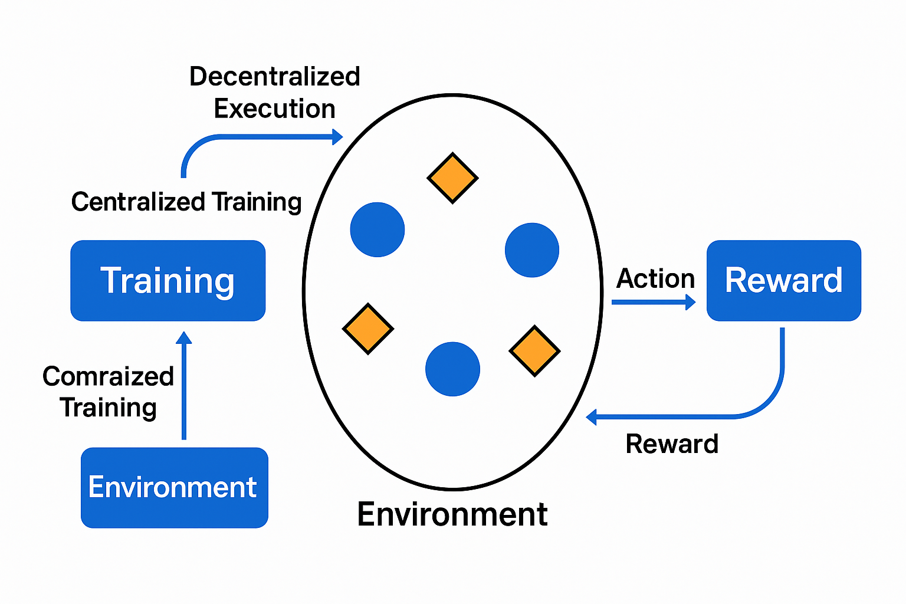
Framework
Training: Centralized training with decentralized execution (CTDE).
Environment: simple_spread_v3 from MPE 3 agents, landmarks.
Reward: Combines proximity, coverage, and collision penalties.

Slide 9
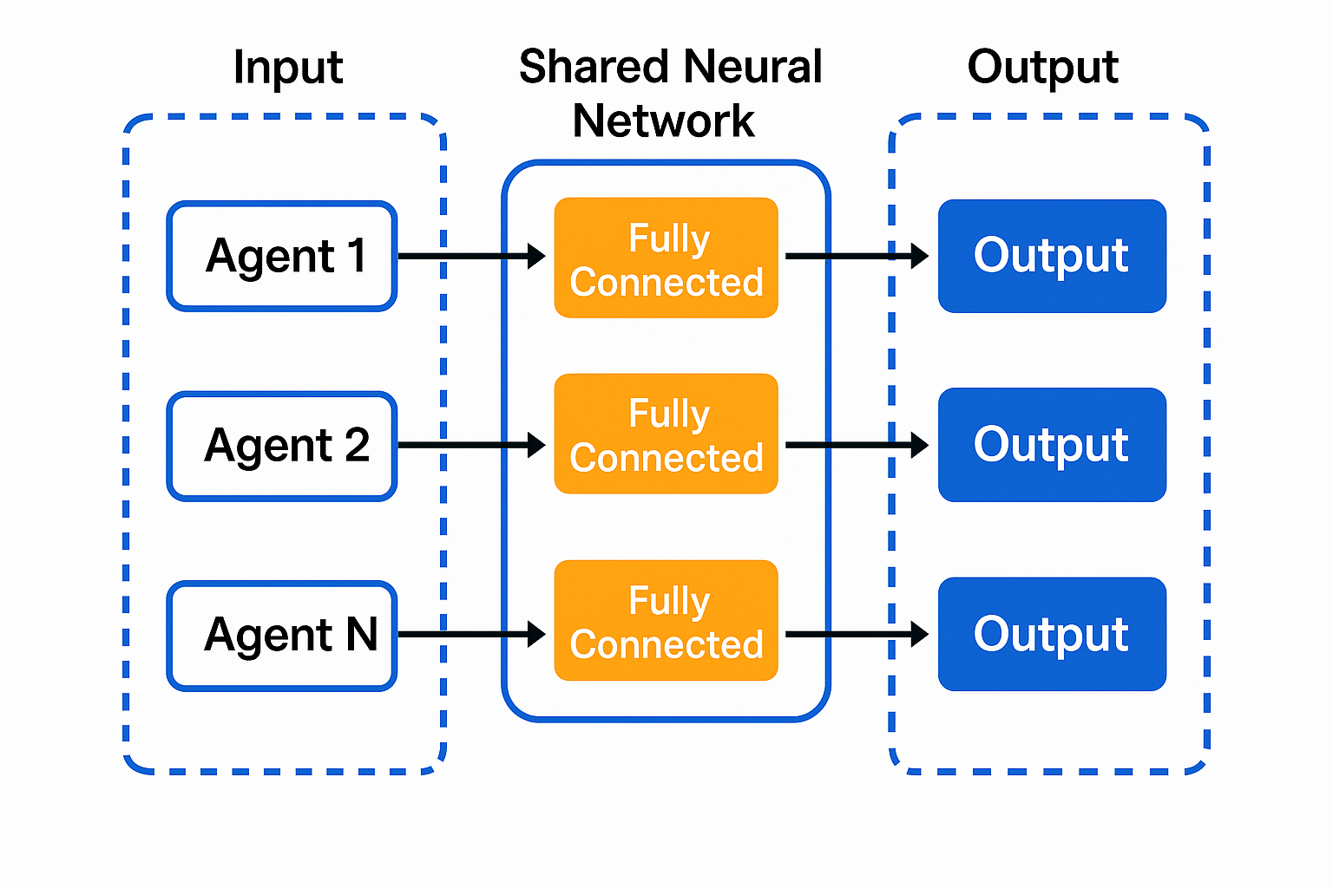
Novelty of Proposed Work
Flow: Observation → VAE → GNN → Policy → Action
Message Passing: Gumbel softmax allows differentiable discrete communication.
Critic: Learns a global value function using concatenated agent observations.

Slide 10
GACRL ALGORITHM
1. Initialize encoder, GNN message model, policy network, and central critic.
2. For each episode:
a. Reset the environment and adjust curriculum (learning rate, exploration).
b. For each timestep:
i. Encode observations (VAE) → latent vector z.
ii. Use GNN to pass messages among nearby agents.
iii. Compute actions using policy network + messages.
iv. Execute actions in the environment.
v. Compute reward (shaped with proximity & coverage bonuses).
vi. Store transitions, update networks using policy gradient + KL loss.
c. Log metrics: reward, coverage, distance, collisions.
3. Visualize and print performance after training.
GACRL combines graph-based agent communication (via GNN) with adaptive exploration, allowing agents to coordinate better in tasks like landmark coverage.
The training loop integrates curriculum learning, variational encoding, discrete message passing, and centralized value estimation, achieving effective learning in complex cooperative environments.

Slide 11
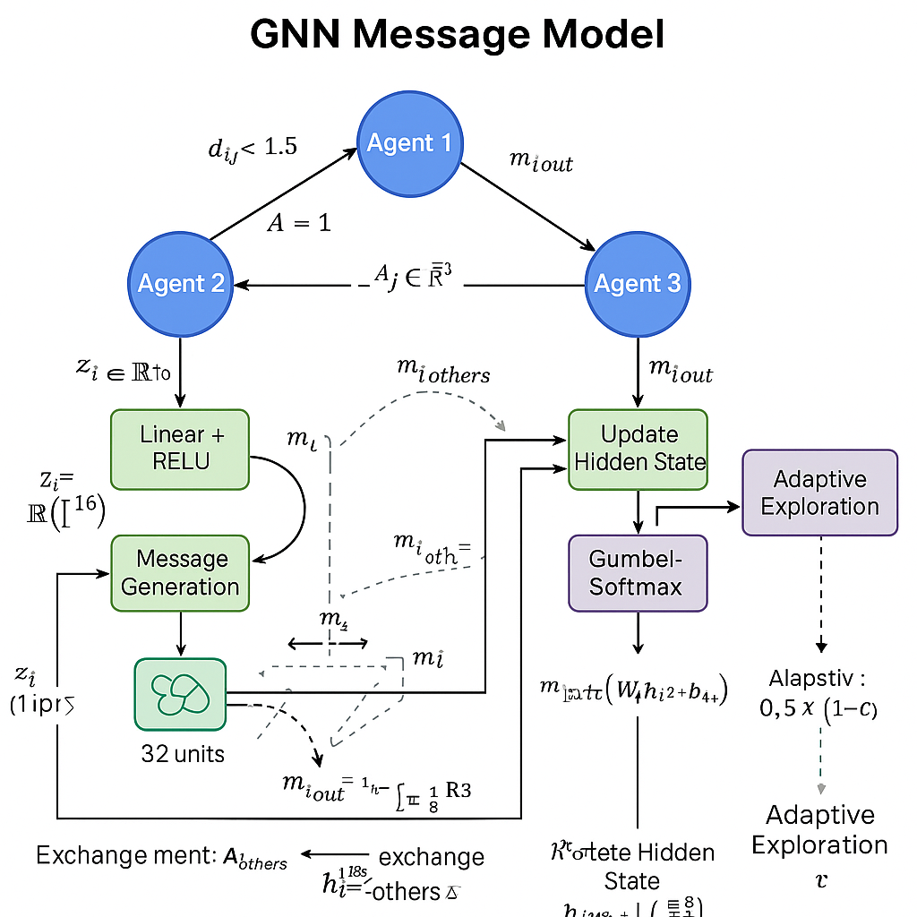
GNN MESSAGE MODEL
GNN enables structured communication in spatial MARL.
Gumbel SoftMax allows learning discrete message-passing strategies.
Adaptive exploration dynamically adjusts communication entropy to encourage coordination when agents perform poorly.

Slide 12
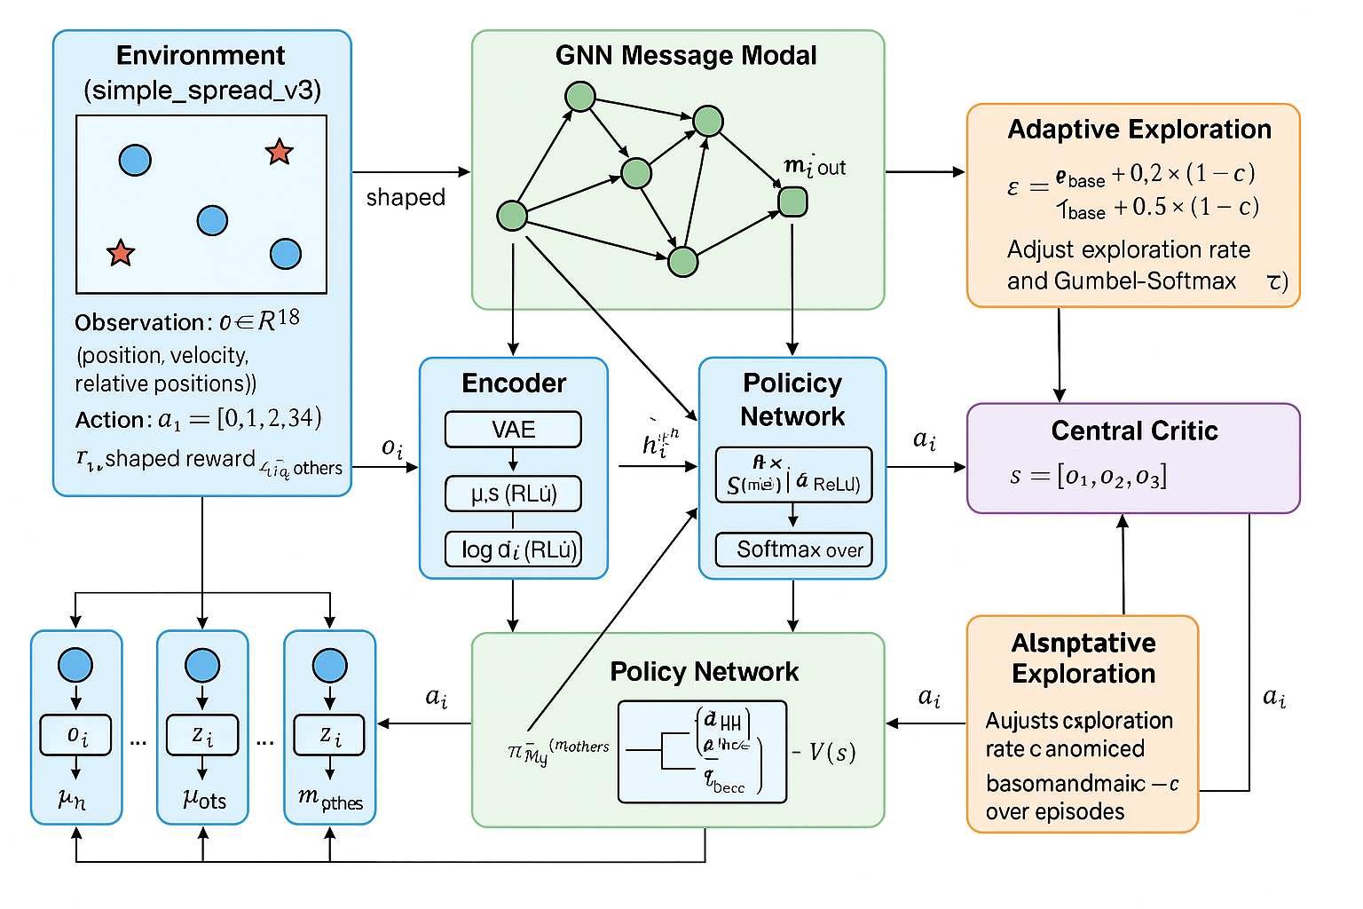
Architecture

Slide 13
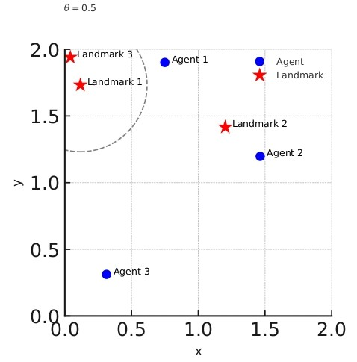
Environment
The environment is a 2D space of size 2.0 × 2.0 containing 3 agents and 3 landmarks.
Agents (blue) aim to cover landmarks (red stars) by moving close to them.
A landmark is considered covered if an agent is within a radius threshold 𝜃=0.5θ=0.5.
Rewards are based on proximity to landmarks, successful coverage, and collision avoidance

Slide 14
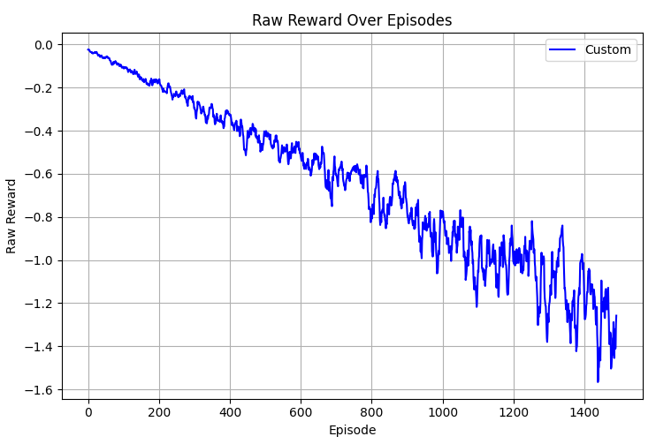
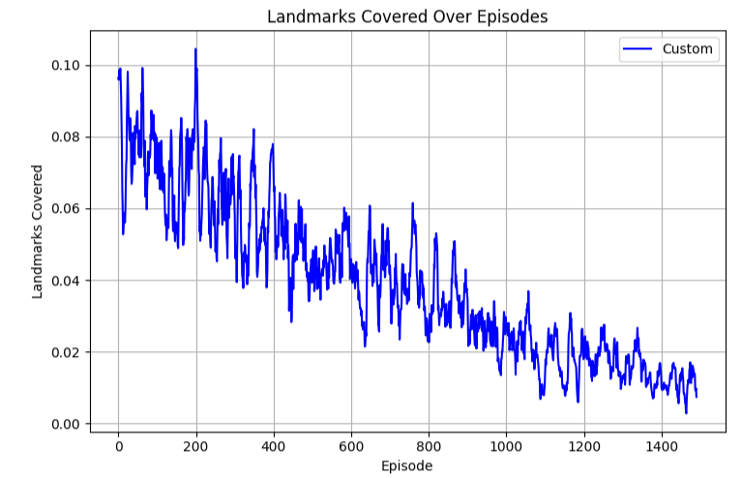
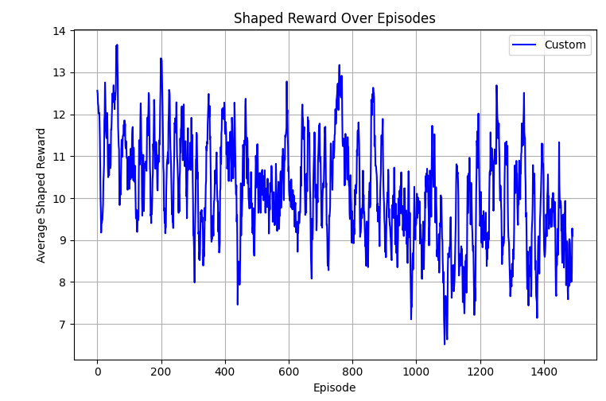
Results
GACRL

Slide 15
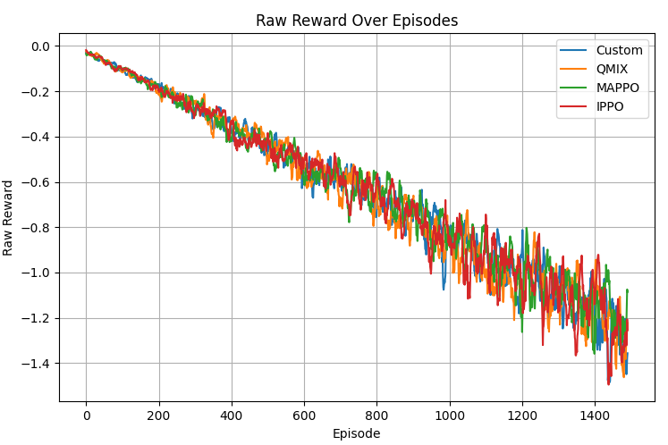
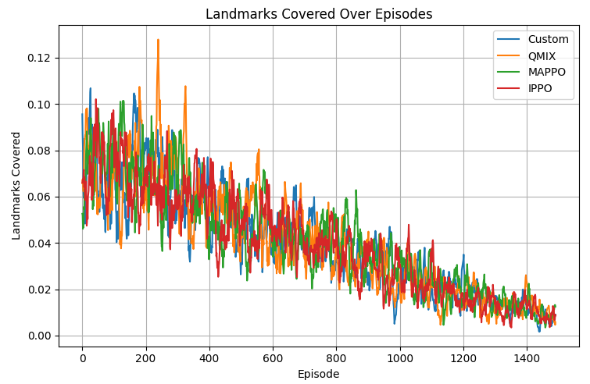
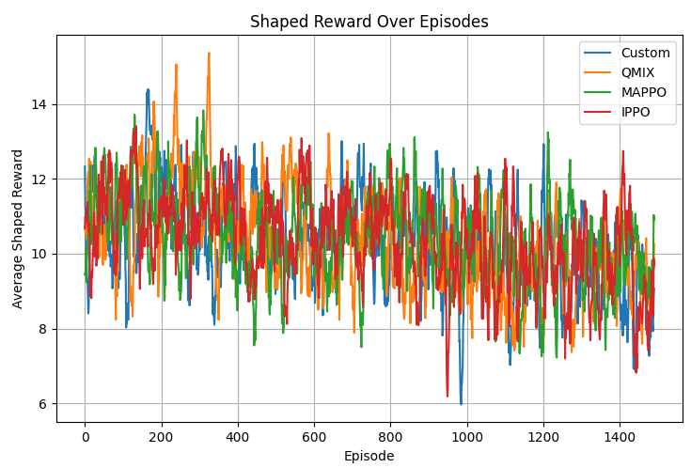
Results
COMPARISON

Slide 16
Results
Algorithm | Shaped Reward | Coverage | Min Distance | Collisions
GACRL | 9.12 ± 3.87 | 0.01 | 1.03 | ~0
MAPPO | 9.53 ± 2.98 | 0.01 | 0.98 | ~0.01
QMIX | 9.30 ± 2.83 | 0.01 | 1.07 | ~0.01
IPPO | 8.68 ± 3.04 | 0.01 | 1.02 | ~0.01

Slide 17
References
[1] L. Bus¸oniu, R. Babuska, and B. De Schutter, “Multi-agent reinforcement learning: A survey,” in Proc. 9th Int. Conf. Control Autom. Robot. Vis.,
2006, pp. 1–6.
[2] K. Zhang, Z. Yang, and T. Bas¸ar, “Multi-agent reinforcement learning: A selective overview of theories and algorithms,” in Handbook of Reinforcement Learning and Control, Springer, 2021, pp. 321–384.
[3] S. Omidshafiei et al., “Deep decentralized multi-task multi-agent reinforcement learning under partial observability,” in Proc. 34th Int. Conf. Mach. Learn., 2017, pp. 2681–2690.
[4] D. Xu, Y. Zhu, and Q. Liu, “Graph neural networks in multi-agent systems: A survey,” IEEE Trans. Neural Netw. Learn. Syst., vol. 33, no. 11, pp. 6234–6248, Nov. 2022.
[5] M. Tokic, “Adaptive ϵ-greedy exploration in reinforcement learning based on value differences,” in Proc. 33rd Annu. Conf. Artif. Intell., 2010, pp. 203–210
[6] R. Lowe et al., “Multi-agent actor-critic for mixed cooperativecompetitive environments,” in Adv. Neural Inf. Process. Syst., 2017, pp.
6379–6390

Slide 18
References
[7] T. Rashid et al., “QMIX: Monotonic value function factorisation for deep multi-agent reinforcement learning,” in Proc. 35th Int. Conf. Mach. Learn., 2018, pp. 4295–4304.
[8] C. Yu et al., “MAPPO: Multi-agent PPO with parameter sharing,” in Proc. 35th Conf. Neural Inf. Process. Syst., 2021, pp. 12345–12356.
[9] J. Schulman et al., “Proximal policy optimization algorithms,” arXiv preprint arXiv:1707.06347, 2017.
[10] J. Jiang et al., “Graph neural networks for multi-agent traffic control,” in Proc. 28th Int. Joint Conf. Artif. Intell., 2019, pp. 123–129.
[11] R. S. Sutton and A. G. Barto, Reinforcement Learning: An Introduction, 2nd ed. Cambridge, MA, USA: MIT Press, 2018.
[12] D. P. Kingma and M. Welling, “Auto-encoding variational Bayes,” in Proc. 2nd Int. Conf. Learn. Represent., 2014.
[13] E. Jang, S. Gu, and B. Poole, “Categorical reparameterization with Gumbel-Softmax,” in Proc. 5th Int. Conf. Learn. Represent., 2017.

Slide 19
References
[14] M. Tan, “Multi-agent reinforcement learning: Independent vs. cooperative agents,” in Proc. 10th Int. Conf. Mach. Learn., 1993, pp. 330–337.
[15] J. Foerster et al., “Learning to communicate with deep multi-agent reinforcement learning,” in Adv. Neural Inf. Process. Syst., 2016, pp. 2137–2145.
[16] S. Sukhbaatar, A. Szlam, and R. Fergus, “Learning multiagent communication with backpropagation,” in Adv. Neural Inf. Process. Syst., 2016, pp. 2244–2252.
[17] Q. Li et al., “Graph neural networks for decentralized multi-robot control,” in IEEE Int. Conf. Robot. Autom., 2021, pp. 3456–3462.
[18] T. Haarnoja et al., “Soft actor-critic: Off-policy maximum entropy deep reinforcement learning with a stochastic actor,” in Proc. 35th Int. Conf. Mach. Learn., 2018, pp. 1861–1870.
[19] R. Raileanu et al., “RIDE: Rewarding impact-driven exploration for procedurally-generated environments,” in Proc. 8th Int. Conf. Learn. Represent., 2020.
[20] A. Vaswani et al., “Attention is all you need,” in Adv. Neural Inf. Process. Syst., 2017, pp. 5998–6008.

Slide 20
